Slide 1
I AM SO GLAD YOU ARE HERE!
WELCOME!

Slide 2
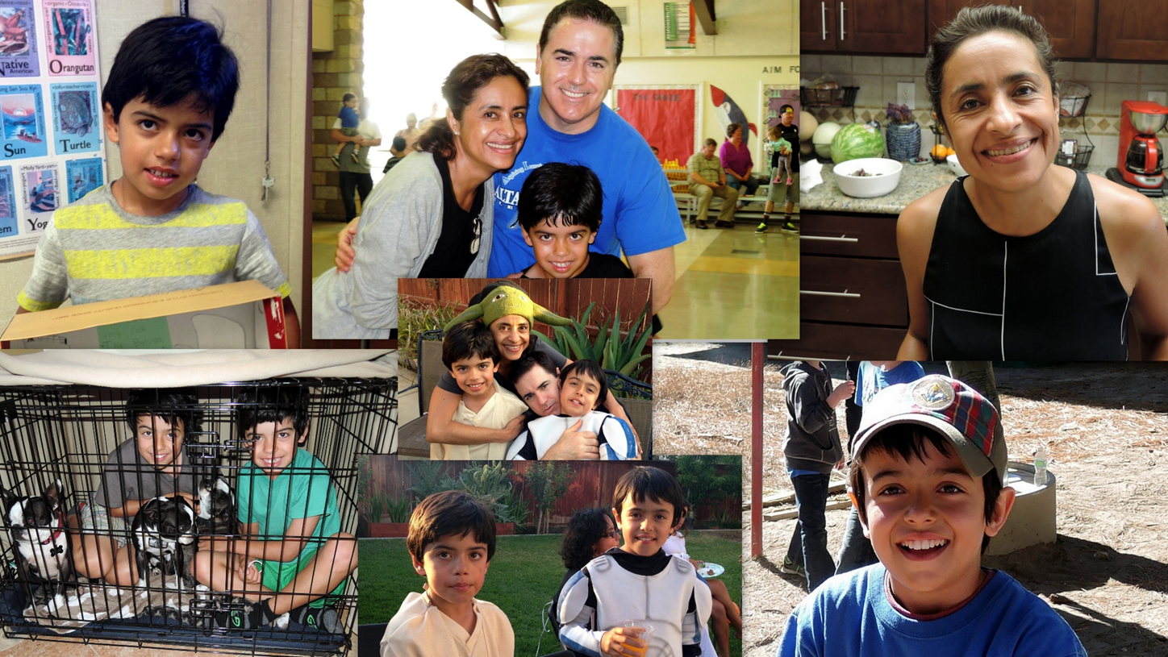

Slide 3
About Me

Slide 4
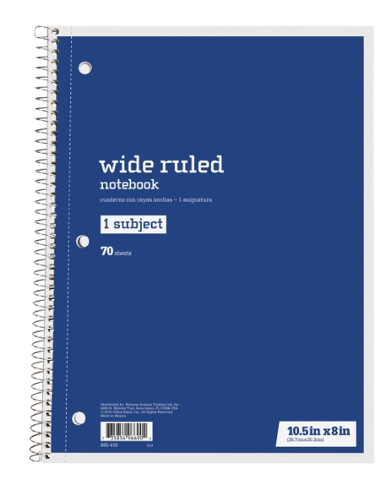
SUPPLIES
BELOW YOU WILL SEE THE SUPPLIES YOUR CHILD WILL USE IN CLASS.

Slide 5
GRADES
Science Essentials
Daily activities make up most of your grade.
Grades will be based on:
Group Project Assessment
Claim, Evidence and Reasoning observation forms.
Miscelanious Classroom assignments related to the standard being taught.

Slide 6
HOMEWORK & INDEPENDENT WORK…
I do not give homework.
If students miss school and have work to make up, we will do so during office hours.

Slide 7
VIRTUAL TOUR
Science Canvas Page

Slide 8
jgold@murrieta.k12.ca.us
Students can email me through Canvas!
(951) 696-1410

